Slide 1
Habits
Tie Ma

Slide 2
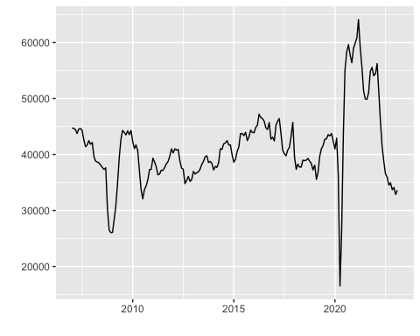
The Canadian housing market sales date
This time series collected by the Canadian Real Estate association (CREA) on the Canadian housing sales from Jan 2007 to Jan 2023.
why this data?
because this is the only interest data with at least 100 observation related to the housing market.

Slide 3
Some found on the data.
The data is randomly walking or close to randomly walking.
The auto.arima function I used while I Played with my data.
This auto.arima setting force auto,arima() to search 15625 combinations of ARIMA from ARIMA(1,1,1)(1,1,1) go to ARIMA (5,5,5)(5,5,5) it will consume a huge amount of computing power. It take my computre around 30s.
all_data_model_1 <- auto.arima(Can_month_housing_sell.ts, approximation = FALSE, parallel = TRUE, stepwise = FALSE, max.Q = 5, max.P = 5, max.D = 5, max.d = 5, max.p = 5, max.q = 5)
will it work better compare to auto.arima() in default setting?
no.

Slide 4
The data analysis for entire time series.
all_data_model_1 <- auto.arima(Can_month_housing_sell.ts, approximation = FALSE, parallel = TRUE, stepwise = FALSE, max.Q = 5, max.P = 5, max.D = 5, max.d = 5, max.p = 5, max.q = 5) print(all_data_model_1) #ARIMA(2,1,0) ### so, what dos the default auto-arima will give me and how long it take? #0.025s and ARIMA(0,1,1) all_data_model_2 <- auto.arima(Can_month_housing_sell.ts) print(all_data_model_2) #ARIMA(0,1,1) random walk with draft. #######################so, which one is better? ######compare the AIC? AIC(all_data_model_2) AIC(all_data_model_1)

Slide 5
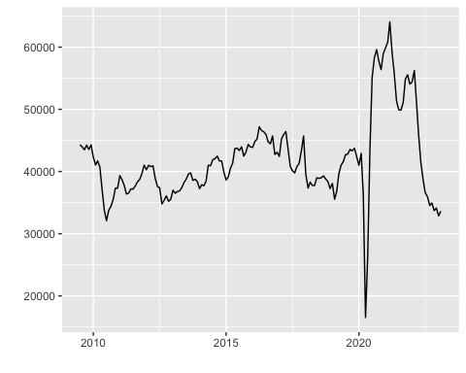
How about not including the 2008 finical crash?

Slide 6
Result ARIMA(0,1,1) AIC: 3041.171 ARIMA(2,1,0) AIC: 3038.807 still, random walk with drift?

Slide 7
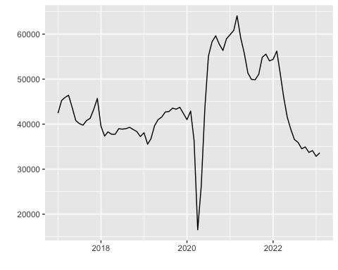
How about 3 years before and after 2020 when the covid start to impact canada?
The_before_during_after_Covid_model.data<-window(Can_month_housing_sell.ts, start= c(2017,1), end= c(2023,2)) autoplot(The_before_during_after_Covid_model.data)

Slide 8
still ARIMA(2,1,0) and ARIMA(0,1,1) the random walk drift. even the AIC is supre close AIC(The_before_during_after_Covid_model_1) #1413.121 AIC(The_before_during_after_Covid_model_2) #1413.473

Slide 9
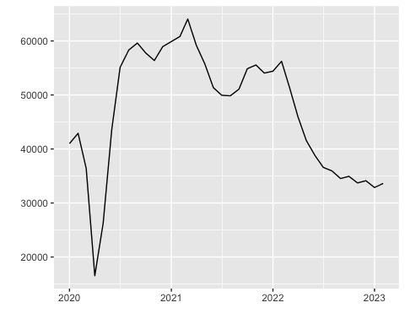
constructed model 2: what if we only including the data from 2020 alone?
A scatterplot.

Slide 10
Both auto.arima suggest the data is random walk with ARIMA(0,1,1)

Slide 11
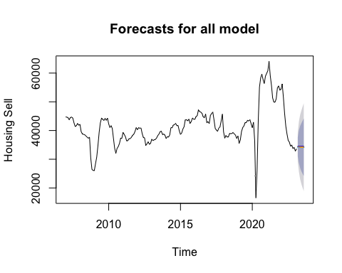
So, here is my forecasting base on all the model I got from auto.arima

Slide 12
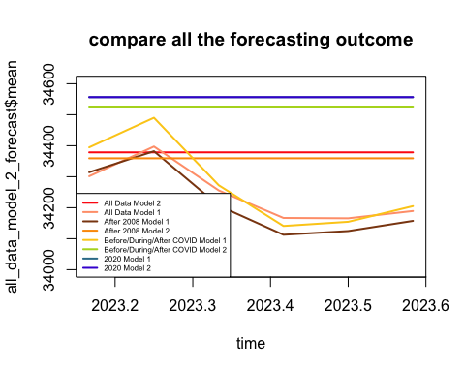

Slide 13
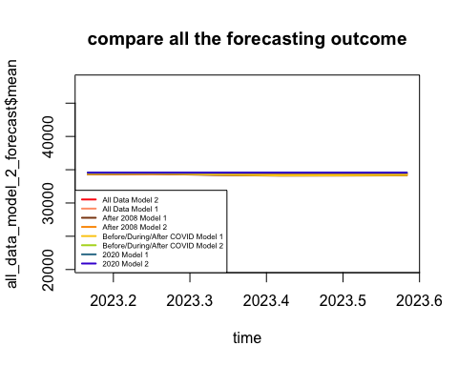

Slide 14
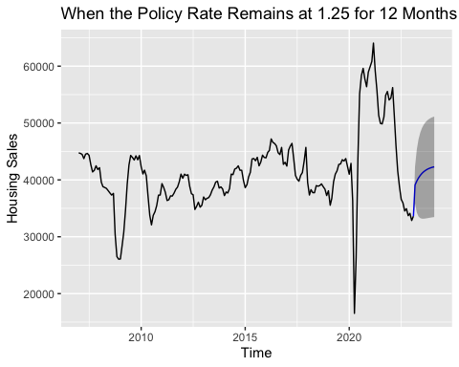
## [1] 1.25 1.25 1.25 1.25 1.25 1.25 1.25 1.25 1.25 1.25 1.25 1.25

Slide 15
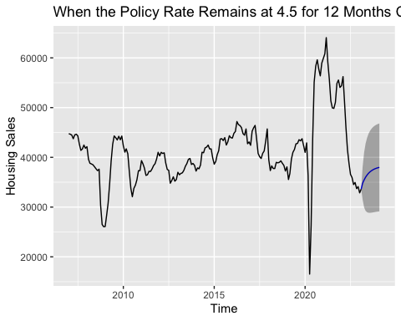
## [1] 4.5 4.5 4.5 4.5 4.5 4.5 4.5 4.5 4.5 4.5 4.5 4.5

Slide 16
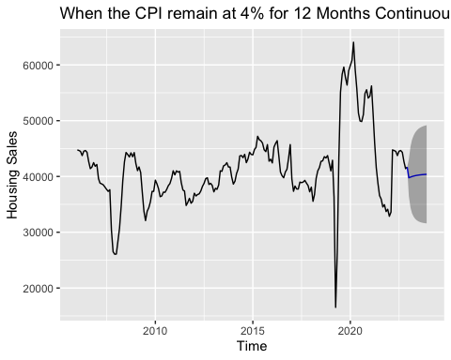

Slide 17
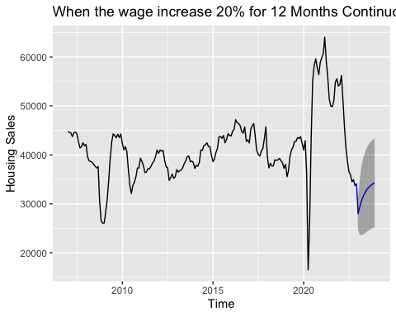

Slide 18
